Slide 1
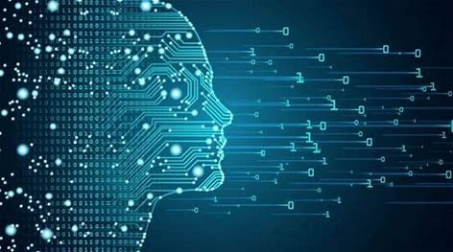
Machine Learning Model For Academic Purposes
Problem Statement
Students often need a fast and efficient way to access academic information, like exam schedules, results, and course details, without having to search multiple portals or make in-person visits. A machine learning model can be developed to serve as a virtual assistant on an academic portal, understanding and responding to students' questions. This model will use natural language processing (NLP) to interpret queries and provide quick, accurate answers, making it easier for students to find the information they need.
Algorithms Used:
The neural network algorithm enables the virtual assistant to accurately understand and respond to students' queries by learning and recognizing patterns in natural language. This allows the model to provide precise, context-aware answers, making the academic portal more reliable and efficient. As the neural network learns from new data, the model continues to improve, ensuring that it remains responsive and effective in meeting students' needs.
Student Query Data: dataset.xlsx This model leverages neural network algorithms to interpret and respond to queries in natural language. By analysing student query data from Kl ERP, the model provides accurate and contextually relevant answers, streamlining the process of information retrieval.
Input : Queries and Metadata Output: Filled-in Responses
TEAM 17 2320040069 – Laasika Anuga 2320040075 – Gamana Chirumamilla 2320040080 – Gayathri Yerra

